Slide 1



Sales Data Report
Presented BY – Susmita khanra
Date – 6 Aug 2024

Slide 2

Overview
Introduction
Problem Statement
Benefits
Objectives
Dashboard
Insights
Summary

Slide 3
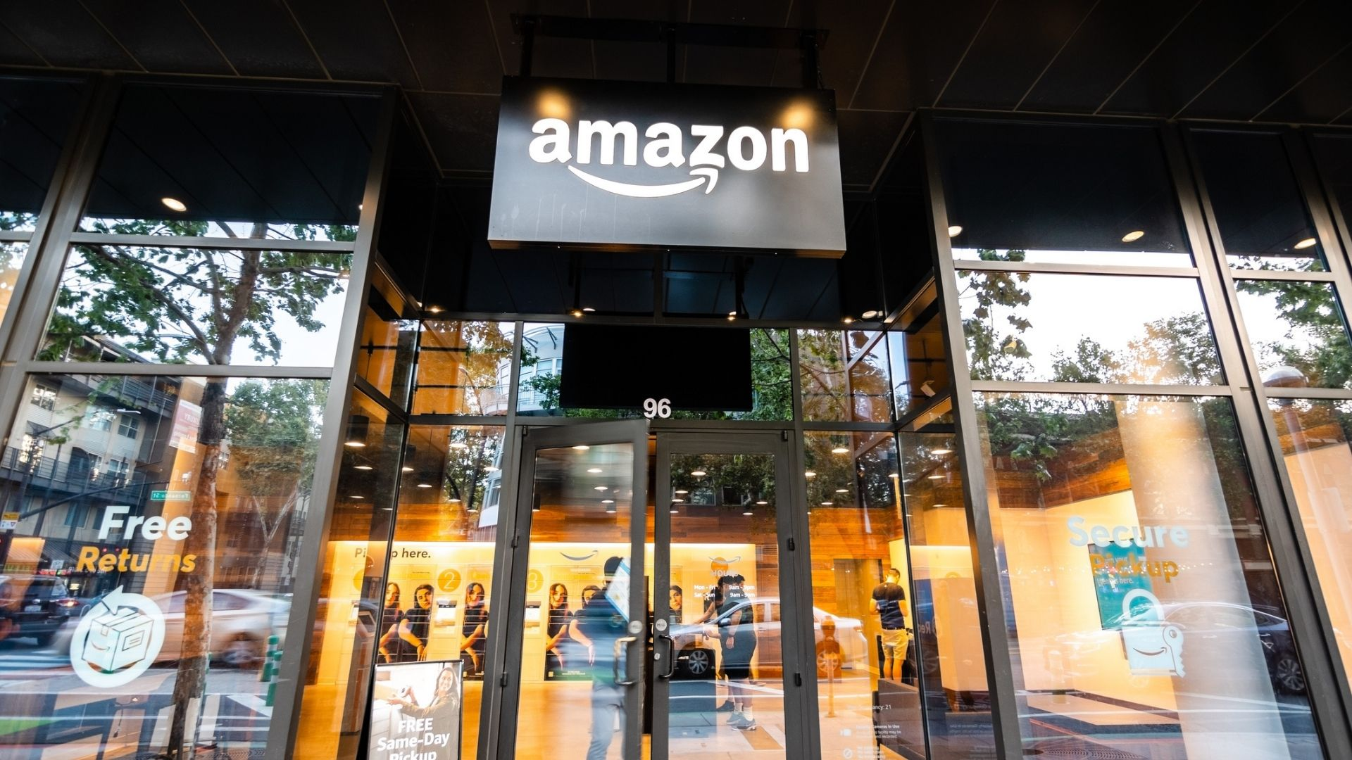

Introduction
Amazon, founded by Jeff Bezos in 1994, started as an online bookstore and has since diversified to offer a wide range of products and services.
In the era of digital transformation, Amazon has emerged as a global e-commerce giant, revolutionizing the way consumers shop and businesses operate.
With a vast and diverse product portfolio, extensive geographical reach, and innovative sales channels, Amazon’s sales data offers a rich source of insights into consumer behavior, market trends, and operational efficiency.
This report delves into an extensive analysis of Amazon’s sales data between (2010-2017). By leveraging this data, I aim to uncover significant patterns and trends that can inform strategic decision and enhance business performance.

Slide 4

Problem Statement
Sales management today is the most important function in a commercial and business enterprise.
Sales management need for improved methods of distribution to reduce cost and to increase profits.
Find key metrics and factors and show the meaningful relationships between attributes.

Slide 5

Benefits
Help out to make better business decisions.
Help analyze customer trends and satisfaction, which can lead to new and better products and services.
Gives better insight of customers base.
Helps in easy flow for managing resources.

Slide 6
Objective
In the competitive landscape of e-commerce, effective sales management is crucial for optimizing business performance.
This project aims to conduct a comprehensive analysis of Amazon sales data to provide actionable insights for enhancing sales strategies and maximizing profitability.
Through exploratory data analysis of the dataset, the project seeks to uncover tends and patterns related to revenue, sales performance, items sold and sales channel.
The goal is to equip sales management with detailed insights to drive informed decision-making and support strategic business growth.

Slide 7
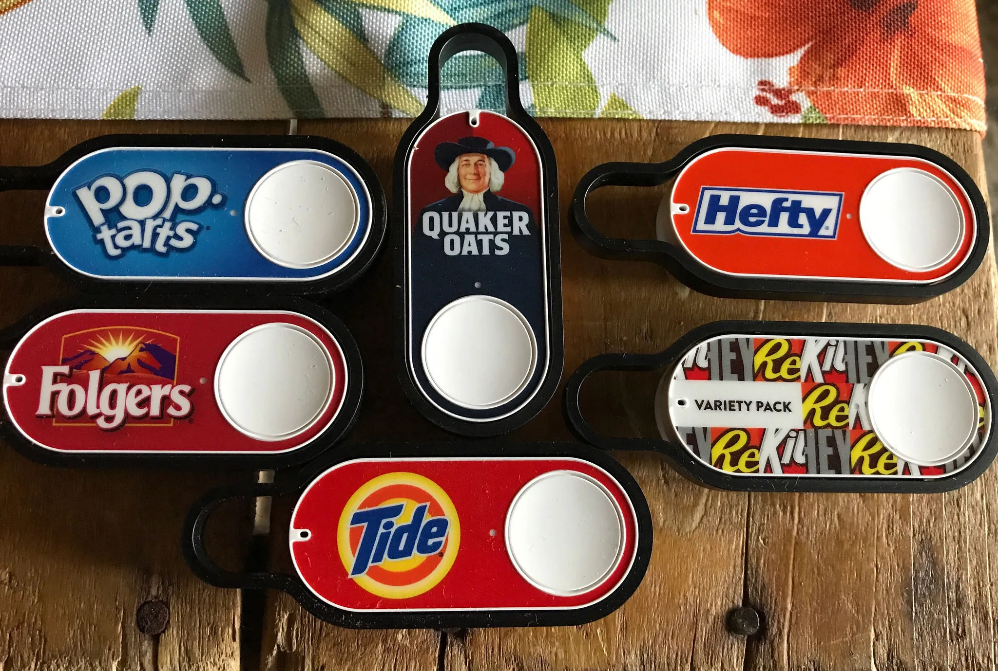
DASHBOARDS AND INSIGHTS

Slide 8
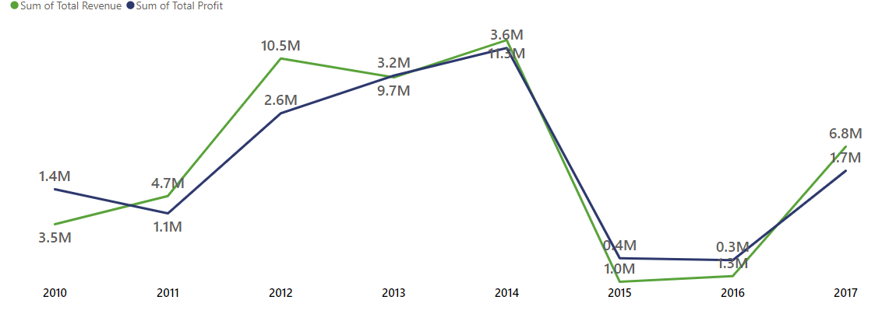
Timeline
As observed from the given dataset from year 2010-2017, in the fiscal year of 2014 the Revenue gained is $11.3M and the Profit earned is $3.6M.
On moving further on the timeline, there is a decrease in revenue and profit in 2015 which keeps on decreasing till 2016.

Slide 9
Key Performance Indicator
Revenue
$48.71M
Profit
$14.37M
Sales
$34.33M
Unit Sold
$159K
Presented By Susmita Khanra

Slide 10
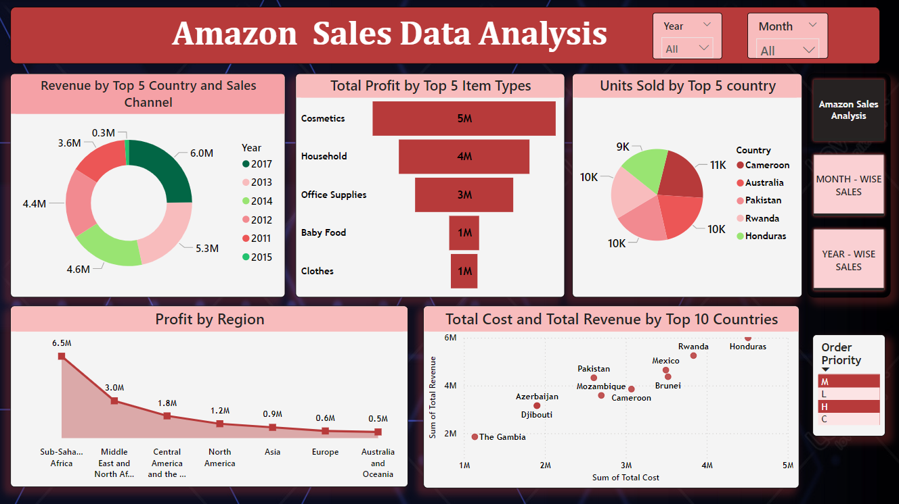

History

Slide 11
Insights
Total profit by Top5 products: Cosmetics gained $2M profit in FY2013 followed by Household($4M), Office Supplies($3M) and Cloths by $1M.
Unit Sold by Top5 Countries: Cameroon has highest unit sold by 10948 in FY2011 followed by Australia and least unit sold by Honduras is 8974 in FY2017.The maximum number of products sold in FY 2013.
Total Cost and Revenue by Top10 Countries: In FY 2014 max cost and revenue was generated by Honduras Country.
Profit by Region: Sub- Saharan Africa generated a highest profit through out the year is $65,30,385.25.
Presented By Susmita Khanra

Slide 12
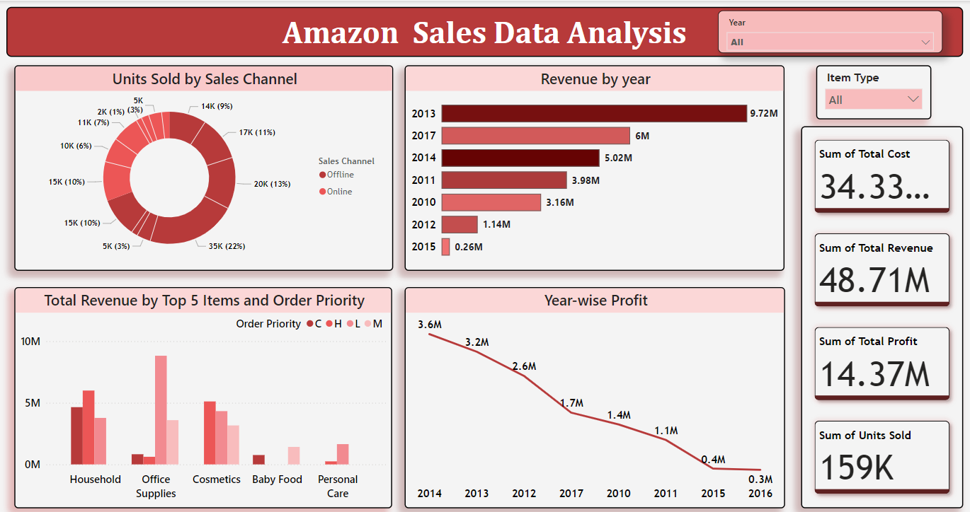
Year – Wise Sales Analysis

Slide 13
Insights
Unit Sold by Channel: 110K unit of products sold by offline and 49K unit of products sold by online. Beverages (23K) is the highest selling products by offline followed by Cosmetics (22K) and Household (21K). This suggests that Amazon is strong retailer for a variety of everyday products. This Show that consumers prefer offline shopping than online.
Revenue by year: In 2013 has highest total revenue including all products. Cosmetics shows the highest total revenue by year(2013,2014 and 2010) is 12.59M followed by Offices Suppliers total revenue by year (2013 and 2011) is 6.89M.
Sales by order priority: Highest order priority orders account for the largest share of total revenue for cosmetics (51,11,742.40) followed by low order priority ( 88,23,244.29) and medium order priority (35,93,376.78) for office suppliers. This suggest that Amazon is able to fulfil a significant number of orders quickly and efficiently.
Yearly profit: 2012 and 2013 are the top sales yearly profit.
Presented By Susmita Khanra

Slide 14
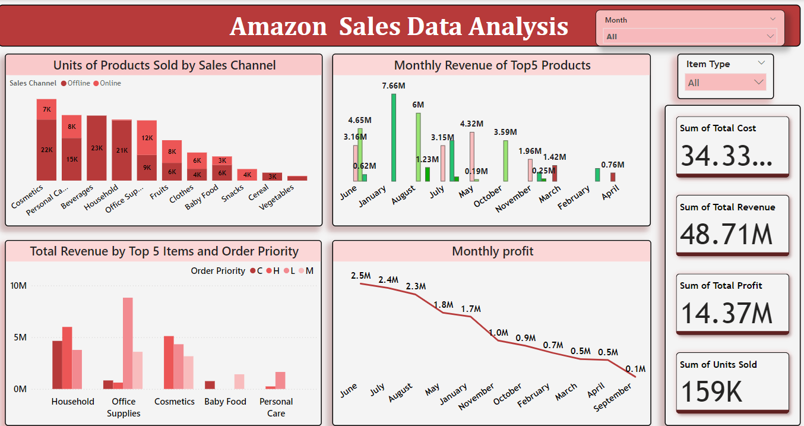
Month – Wise Sales Analysis

Slide 15
Insights
Monthly Profit and Revenue Analysis: Top Sales Months: June, July, and August are identified as the top months for sales.
Monthly Revenue by Top 5 Products: January recorded the highest revenue, with Office Supplies leading at $7.66 million, followed by Household and Cosmetics products. However, the Baby Food category needs improvement.
Units Sold by Sales Channel: July saw the highest number of units sold. Among products, Beverages led offline sales with 23,000 units, followed by Cosmetics with 22,000 units and Household products with 21,000 units. This indicates that offline retail is performing strongly, with consumers showing a preference for in-person shopping over online options.
Total Revenue by Top 5 Products and Order Priority: In June, the top revenue-generating products were Household items, Office Supplies, and Cosmetics. January, July, and August also showed significant revenue contributions.
Presented By Susmita Khanra

Slide 16
Summary
2013 had the highest revenue at 9.72M.
If we observed the monthly insights of the sales are at their peak in June, July & August and are low in September, March & April. Amazon can come up with some good discount and offers to generate high Revenue.
The sales for the Honduras are highest among all countries and lowest in The Gambia.
The cosmetics & office appliances are the highest selling products in domestic and international markets.
Presented By Susmita Khanra

Slide 17

Thank You
Email ID – khanrasusmita02@gmail.com
LOOKING FOR WORK OPPORTUNITIES
Presented By Susmita Khanra

